Slide 1
Data Science Meets Deep Learning
Dr. Zhao Rui

Slide 2
Agenda
Introduction to Neural Network
Optimizers for Neural Network
Backpropagation
Overfitting and Preventing Tips

Slide 3
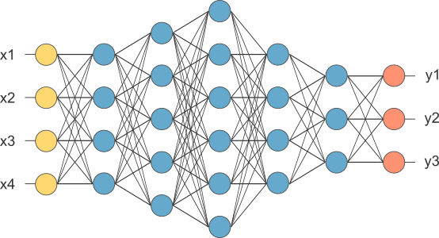
Neural Network
From Wiki:
NN is based on a collection of connected units of nodes called artificial neurons which
loosely model the neurons in a biological brain.
From another way:
NN is running several ‘logistic regression’ at the same time (expanding at width and depth dimensions).

Slide 4
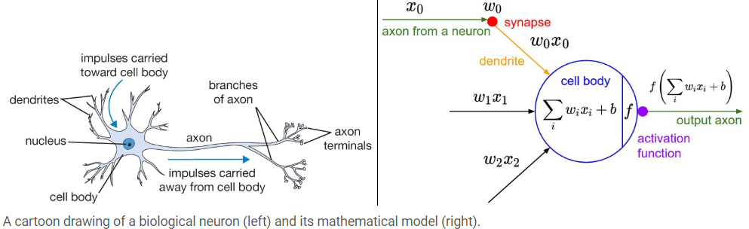
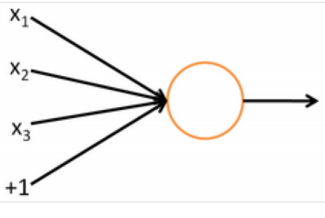
Neuron Computation
The fact that a neuron is essentially a logistic regression unit:
1 performs a dot product with the input and its weights
2 adds the bias and apply the non-linearity

Slide 5
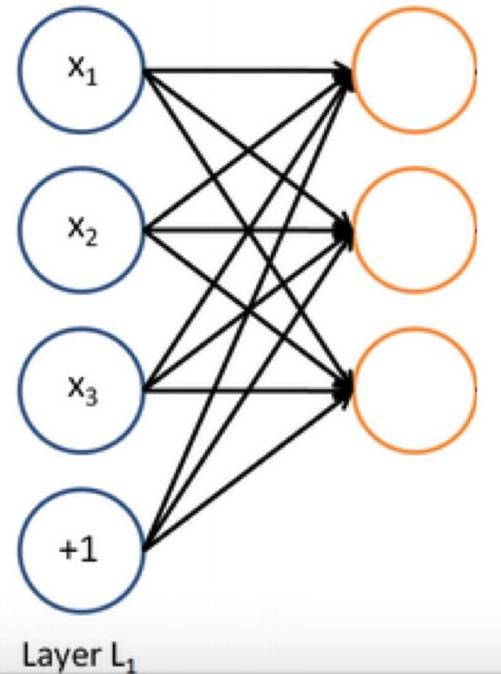
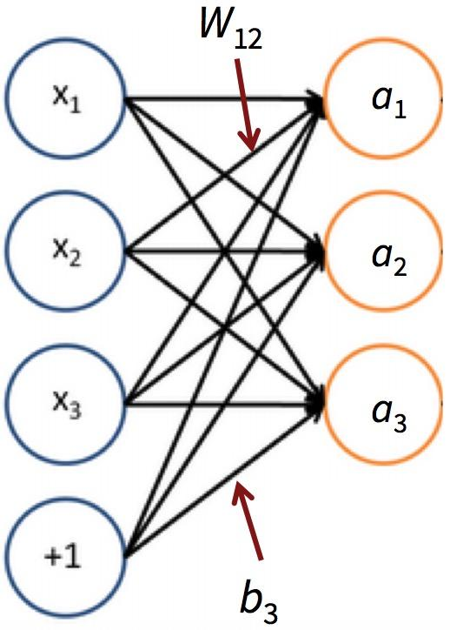


Layer Computation(Width)
Neuron computation: a vector of inputs real-value scalar
Layer Computation: feed a vector of inputs into a bunch of neurons at the same time
Math Notation in matrix:
where is f is applied element-wise
Notes:
The forward pass of a fully-connected layer corresponds to one matrix multiplication followed by a bias offset and an activation function.

Slide 6
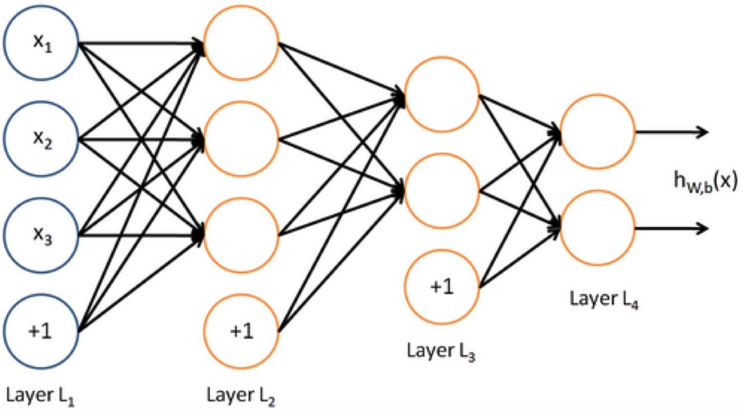
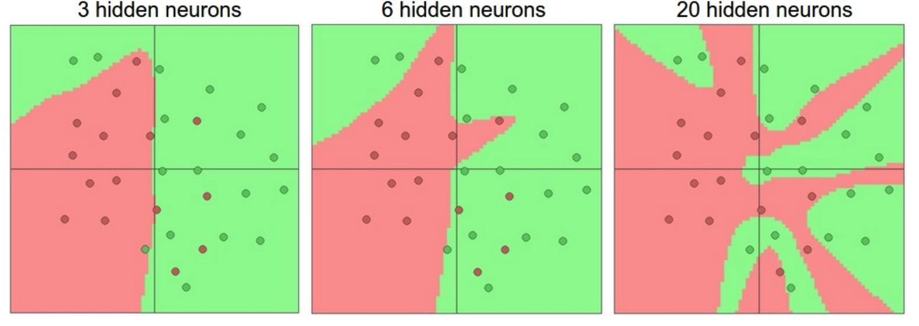
Stacking Layers(Depth)
We can fed the output of one layer into the next layer （a bunch of neuron computation)
The output layer: (not require non-linear activation)
Measures to describe the size of neural networks:
Representation Power: neural networks with at least one hidden layer can approximate any continuous function.
For classification: class scores
For regression: real-value target
Number of neurons: 3 + 2 + 2 = 7
Number of tunable parameters: (biases and weights)

Slide 7
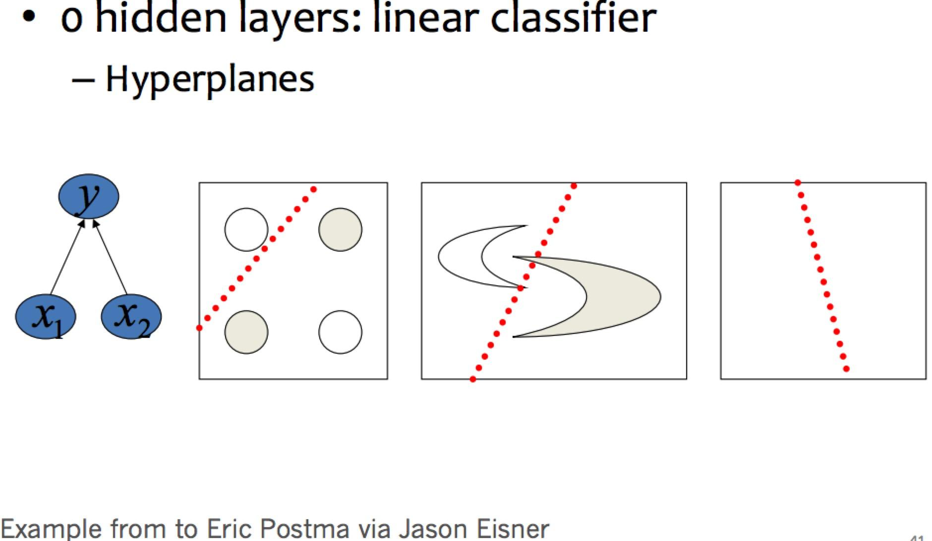
Decision Level
Notes:
https://medium.com/the-theory-of-everything/understanding-activation-functions-in-neural-networks-9491262884e0

Slide 8
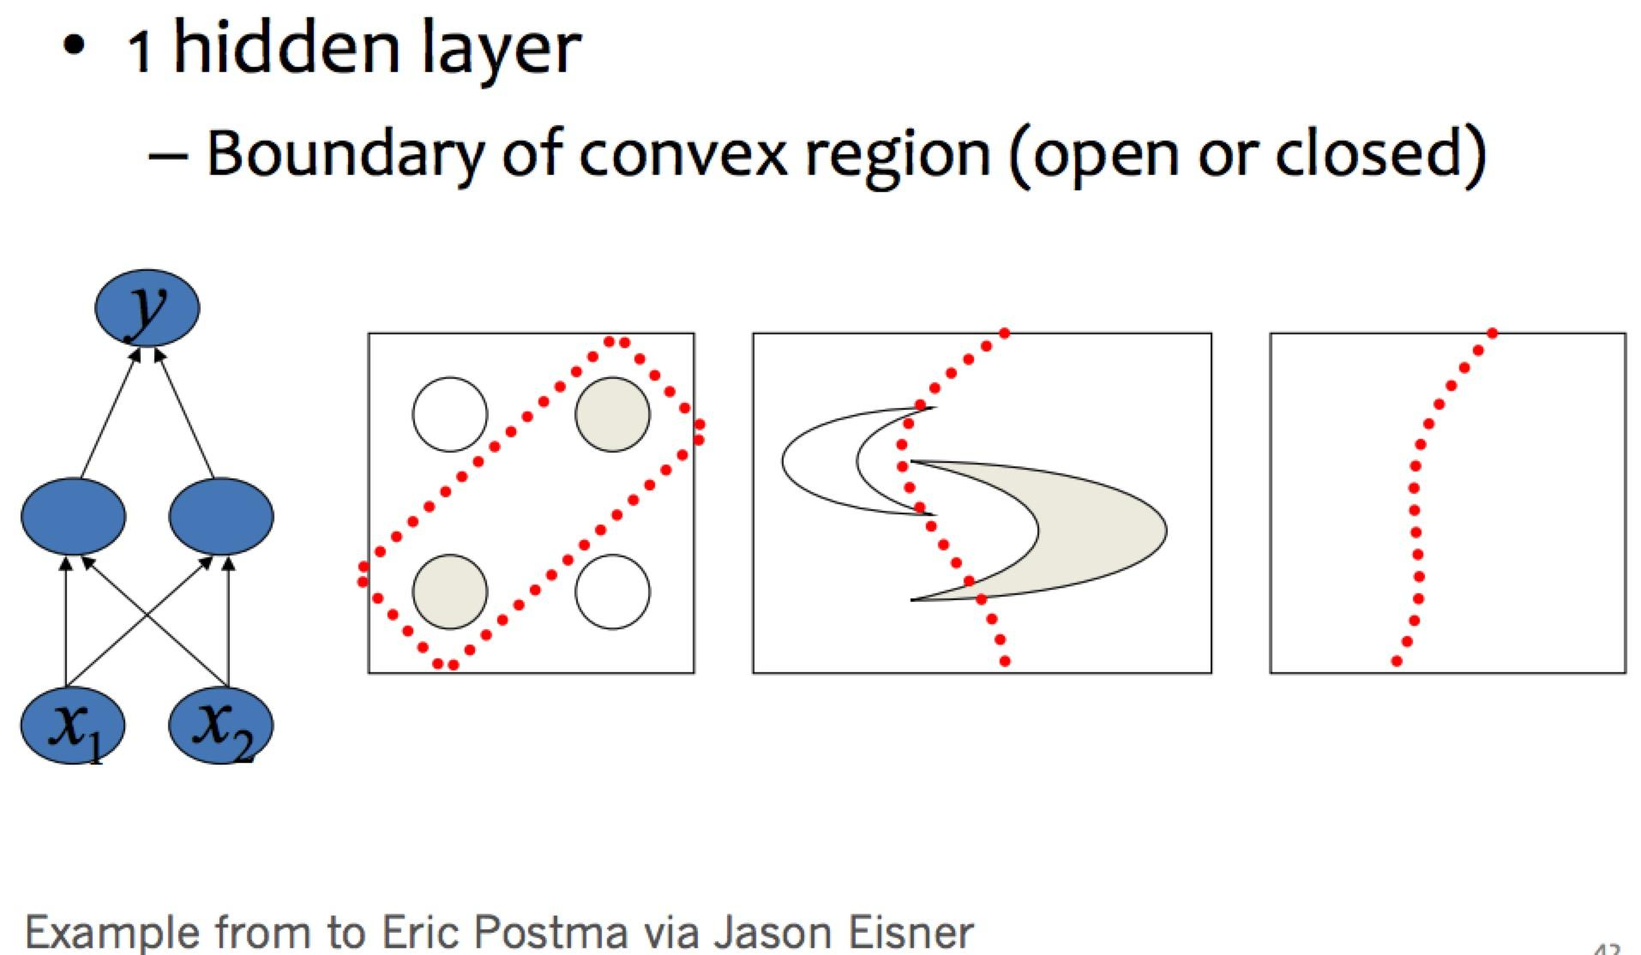
Decision Level
Notes:
https://medium.com/the-theory-of-everything/understanding-activation-functions-in-neural-networks-9491262884e0

Slide 9
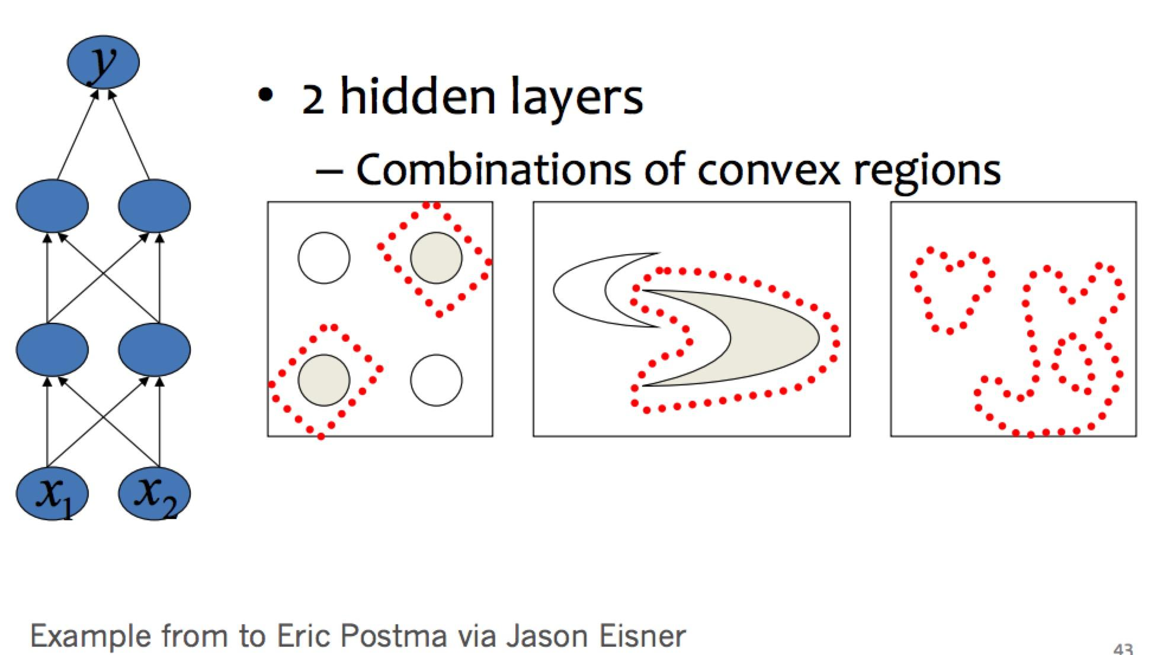
Decision Level
Notes:
https://medium.com/the-theory-of-everything/understanding-activation-functions-in-neural-networks-9491262884e0

Slide 10
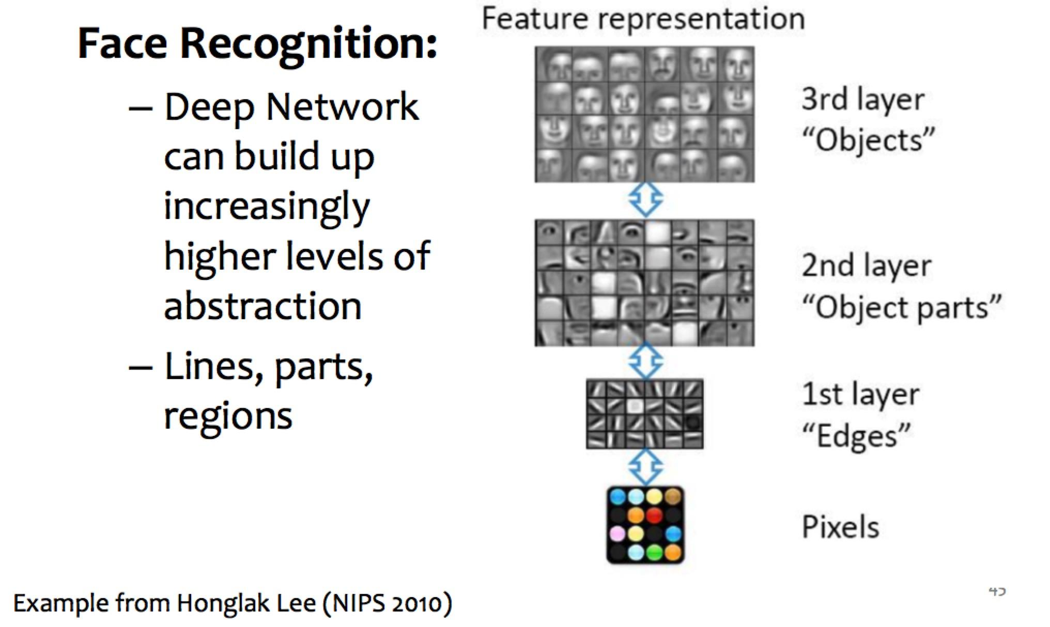
Feature Level
Notes:
https://medium.com/the-theory-of-everything/understanding-activation-functions-in-neural-networks-9491262884e0

Slide 11



Feed-forward Computation
Take f as the non-linear activation
Linear Transformation:
2-layer Neural Network:
3-layer Neural Network:
Neural Network is a model that recursively applies the matrix multiplication and non-linear activation function.

Slide 12
Why Multi-layers
Deep Residual Learning Network (achieved the first place in 2015 ILSVRC image classification) has 152 layers.
Even one single layer can approximate any function, the number of required nodes may be infinite.
It can be more efficient for multi-layer neural network compared to one-hidden-layer network
Since a single sufficiently large hidden layer is adequate for approximation of most functions, why would anyone ever use more? One reason hangs on the words “sufficiently large”. Although a single hidden layer is optimal for some functions, there are others for which a single-hidden-layer-solution is very inefficient compared to solutions with more layers.
From the book ‘neural smithing’

Slide 13
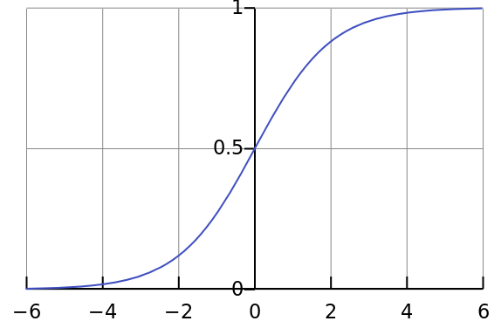
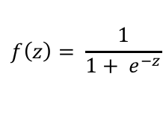
Non-linear Activation Function
Sigmoid Function:
Keep activation bound in range (0,1)
Good for classification problem (clear distinctions)
Smooth non-linear function
Vanishing gradients (near –horizontal part of the curve)
Notes:
https://medium.com/the-theory-of-everything/understanding-activation-functions-in-neural-networks-9491262884e0

Slide 14
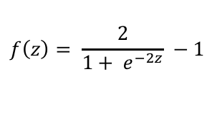
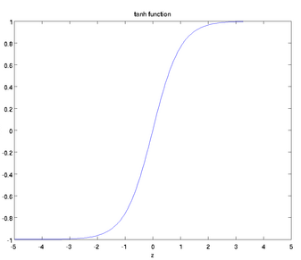
Non-linear Activation Function
Tanh Function:
Keep activation bound in range (-1,1)
More steeper curve
Smooth non-linear function
Vanishing gradients (near –horizontal part of the curve)
Notes:
https://medium.com/the-theory-of-everything/understanding-activation-functions-in-neural-networks-9491262884e0

Slide 15
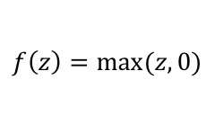
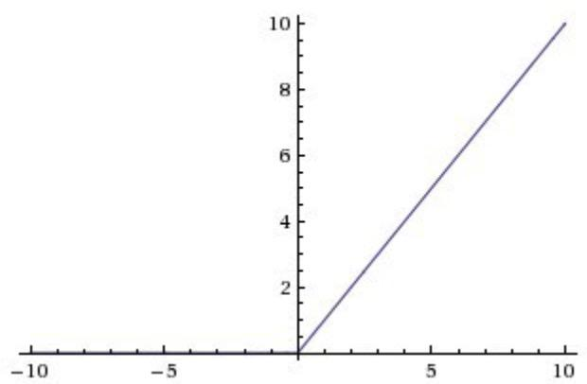
Non-linear Activation Function
ReLu Function:
Nonlinear Activation, but may blow up (gradient is one)
Sparsity/ Efficient
Less computational expensive that is good for deep structure
Dying ReLu problem. (Several neurons will not respond)
Notes:
https://medium.com/the-theory-of-everything/understanding-activation-functions-in-neural-networks-9491262884e0

Slide 16

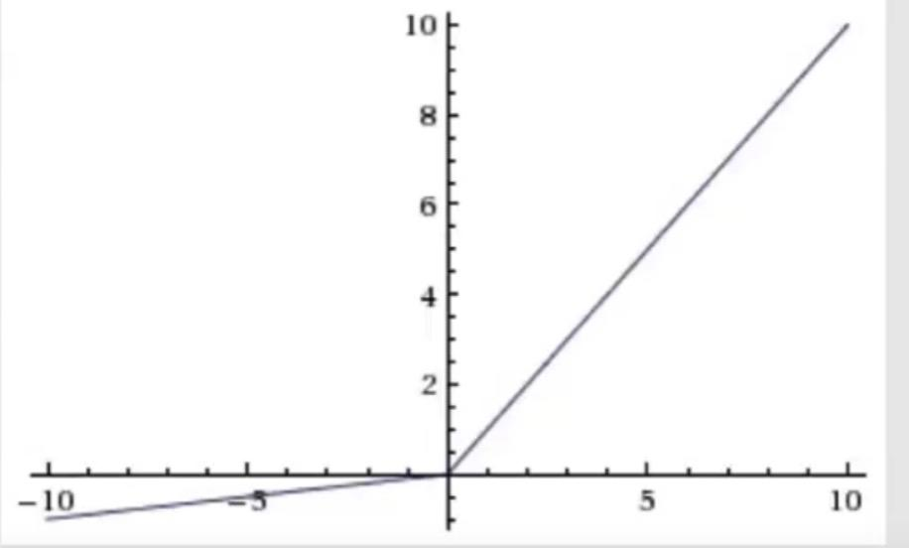
Non-linear Activation Function
Leaky ReLu Function:
Proposed to solve the dying ReLu problem
Still non-linear
Notes:
https://medium.com/the-theory-of-everything/understanding-activation-functions-in-neural-networks-9491262884e0

Slide 17
Why Non-linear Activation
The non-linearities activation function increase the capacity of model
Without non-linearities, deep neural networks is meaningless.
How to select activation functions?
you can select an activation function which will approximate the function faster leading to faster training process.
one personal advice is to start with ReLU, which is a general approximator at most of the time.
Extra layers is just one linear transform:

Slide 18
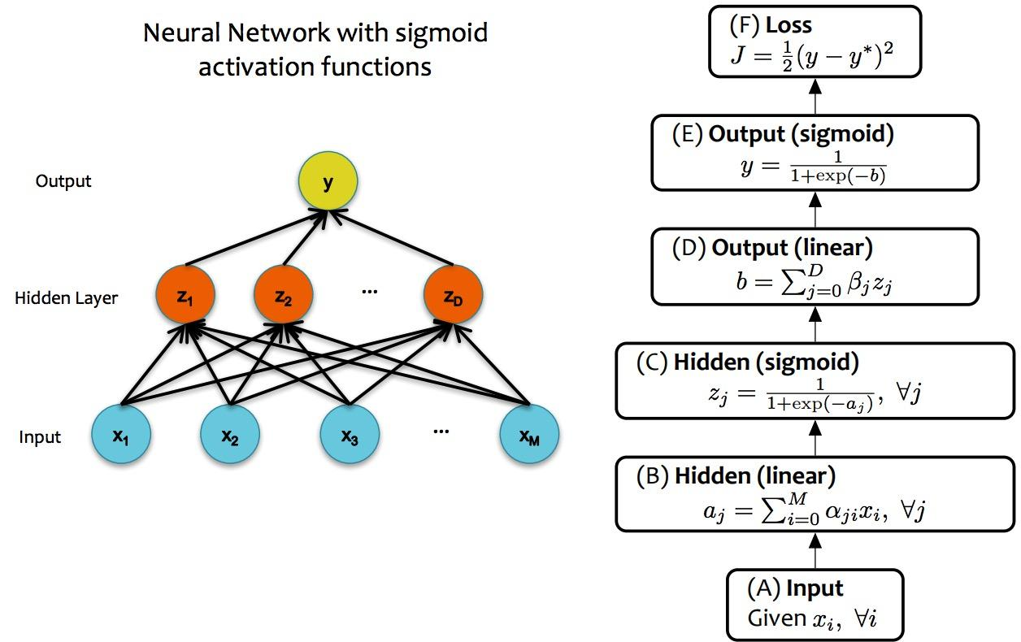
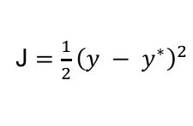
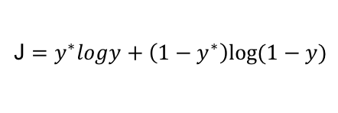
Loss Function
Regression: Mean-squared Error
Classification: Cross-entropy Error (y* is the ground-truth
label)
From Matt Gormley

Slide 19
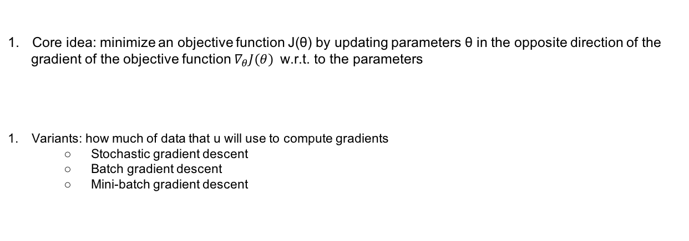
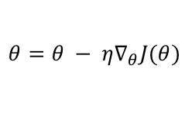
Gradient Descent Algorithms

Slide 20
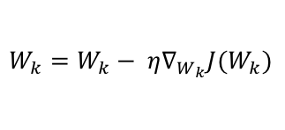
Stochastic Gradient Descent
Given training data (X1, d1), (X2, d2), …, (XT, dT)
Initialize all weights W1, W2, …, WK
Do
For all t = 1: T
For every layer k:
Compute the gradient of the layer parameters
Update model parameters
Until loss value have converged

Slide 21
Batch SGD
Batch SGD
1 only update model parameters after all training data have been evaluated.
2 stable error gradient
3 need a large memory
4 may lead to a less optimal solution

Slide 22
Mini-batch SGD
Mini-batch SGD: split the dataset into small batches and take the average of the gradient over the batch and update the weights
1 more efficient than SGD
2 requires additional hyperparameter i.e. mini-batch size
3 hints on batch size:
* a power of two that fits the memory requirements of GPU or CPU.
* small -> a learning process that converges quickly at the cost of noise in the training
* large -> a learning process that converges slowly with accurate estimate the error gradient

Slide 23
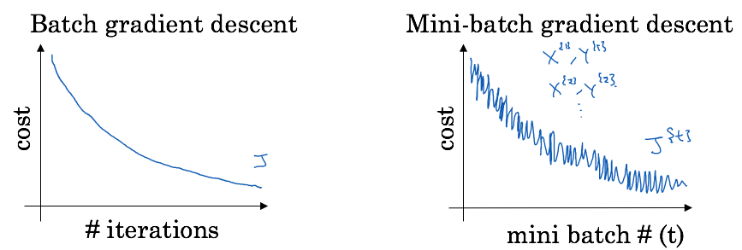
Mini-batch SGD
How about SGD?

Slide 24
Challenges
1 how to select a proper learning rate
2 how to design a proper and data-dependent learning rate schedules
3 same learning rate works for all parameter updates
4 get trapped in various suboptimal local minima.

Slide 25


Momentum
Core idea: the current gradient computation will keep the direction as the previous gradient computation
1 help accelerate SGD
2 dampens oscillations
3 faster convergence

Slide 26

Adagrad
Core idea: different learning rates for different parameters. Smaller updates for parameters associated with frequently occurring features and larger updates for parameters associated with infrequent features.
1 no need to manually tune the learning rate (start with 0.01)
2 good for sparse data
3 the learning rate shrinks all the time

Slide 27


RMSprop
Core idea: exponentially decaying average of squared gradients instead of sum.
1 resolve Adagrad’s radically diminishing learning rates.
2 a good default value is 0.9
Notes:
Smooth operation, in case from divid zero
root-mean-square (RMS)

Slide 28




Adadelta
Core idea: 1 exponentially decaying average of squared gradients instead of sum.
2 use squared parameters updated to replace learning rate
1 no need to set default learning rate
2 similar to RMSprop
3 faster convergence

Slide 29


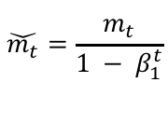
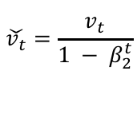

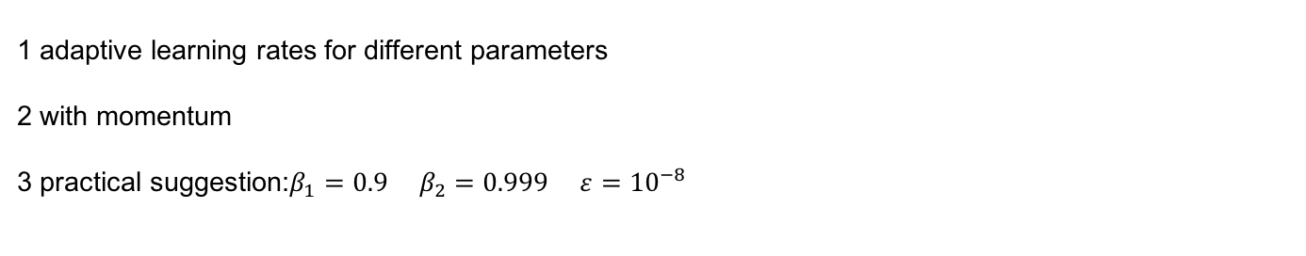
Adaptive Moment Estimation (Adam)
Core idea: 1 exponentially decaying average of squared gradients
2 exponentially decaying average of gradients
Bias-corrected:
Notes:
mtmt and vtvt are estimates of the first moment (the mean) and the second moment (the uncentered variance) of the gradients respectively, hence the name of the method. As mtmt and vtvt are initialized as vectors of 0's, the authors of Adam observe that they are biased towards zero, especially during the initial time steps, and especially when the decay rates are small (i.e. β1β1 and β2β2 are close to 1).
he algorithm uses moving average to estimate the first and second moments. The biased estimation would be, we start at an arbitrary guess m0m0, and update the estimation gradually by mt=βmt−1+(1−β)gtmt=βmt−1+(1−β)gt. So it's obvious in the first few steps our moving average is heavily biased towards the initial m0m0.
To correct this, we can remove the effect of the initial guess (bias) out of the moving average. For example at time 1, m1=βm0+(1−β)gtm1=βm0+(1−β)gt, we take out the βm0βm0 term from m1m1 and divide it by (1−β)(1−β), which yields m1^=(m1−βm0)/(1−β)m1^=(m1−βm0)/(1−β). When m0=0m0=0, mt^=mt/(1−βt)mt^=mt/(1−βt). The full proof is given in Section 3 of the paper.

Slide 30
How to select the optimizer
1 It is hard to find a general answer
2 sparse data -> try adaptive learning-rate methods
3 If u want to train a deep or complex neural networks with fast converge, do not just use SGD.
Notes:
mtmt and vtvt are estimates of the first moment (the mean) and the second moment (the uncentered variance) of the gradients respectively, hence the name of the method. As mtmt and vtvt are initialized as vectors of 0's, the authors of Adam observe that they are biased towards zero, especially during the initial time steps, and especially when the decay rates are small (i.e. β1β1 and β2β2 are close to 1).
he algorithm uses moving average to estimate the first and second moments. The biased estimation would be, we start at an arbitrary guess m0m0, and update the estimation gradually by mt=βmt−1+(1−β)gtmt=βmt−1+(1−β)gt. So it's obvious in the first few steps our moving average is heavily biased towards the initial m0m0.
To correct this, we can remove the effect of the initial guess (bias) out of the moving average. For example at time 1, m1=βm0+(1−β)gtm1=βm0+(1−β)gt, we take out the βm0βm0 term from m1m1 and divide it by (1−β)(1−β), which yields m1^=(m1−βm0)/(1−β)m1^=(m1−βm0)/(1−β). When m0=0m0=0, mt^=mt/(1−βt)mt^=mt/(1−βt). The full proof is given in Section 3 of the paper.

Slide 31

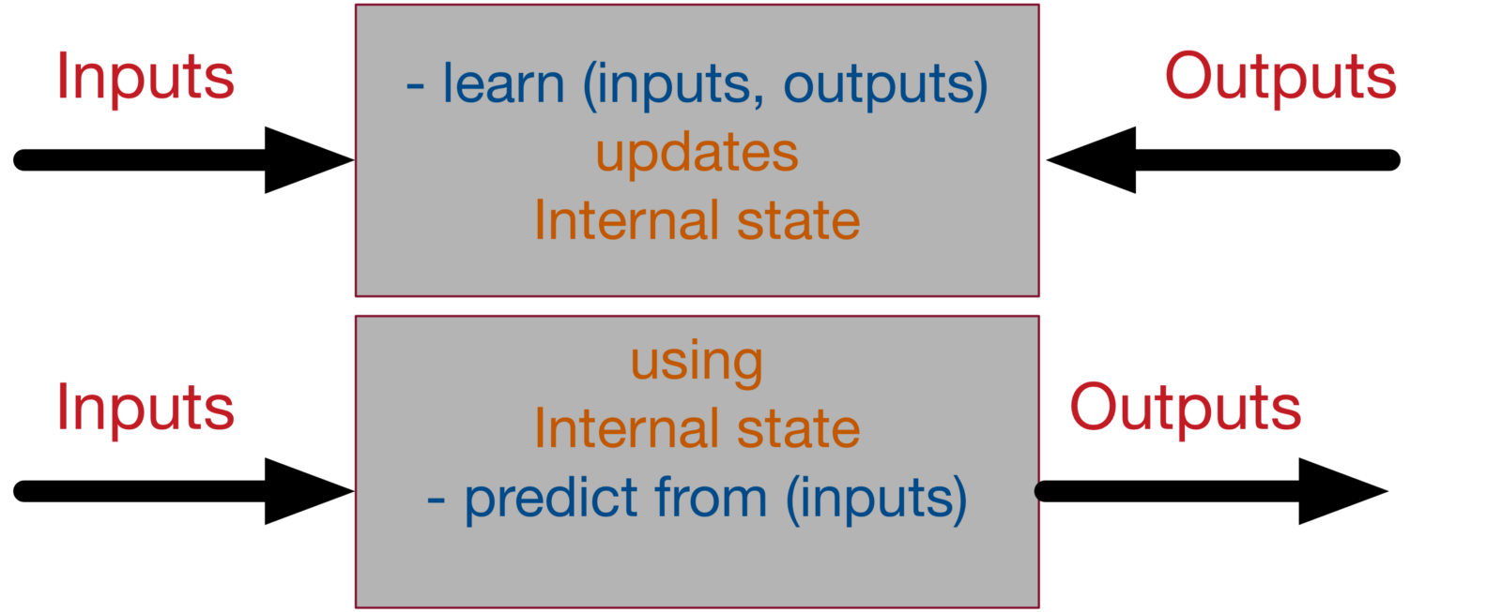


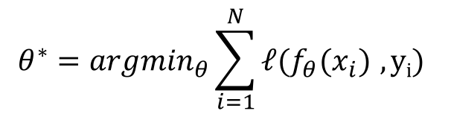

Neural Network WorkFlow
Given training data:
Set decision function:
Compute loss function:
Define optimization goal:
Train with SGD:
Pic from Assaad
How to get the gradient for parameters: Backpropagation

Slide 32
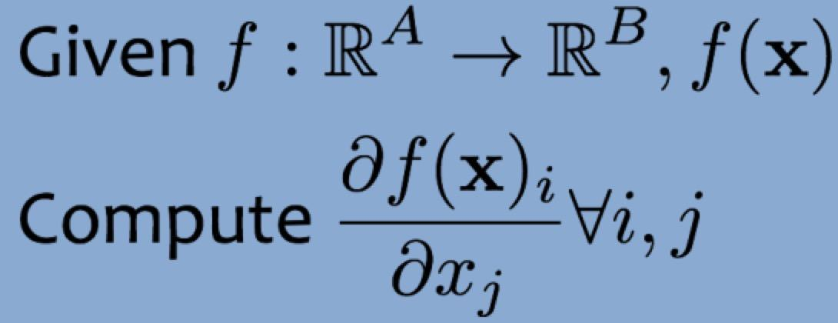
Numerical Differentiation
The method of finite differences: get two points (x, f(x) and (x+h, f(x+h)). Compute the slope
Pro: Great for testing implementations of backpropagation
Con: Slow of high dimensional inputs and outputs
Required: f(x) can be called on any input x

Slide 33
Symbolic Differentiation
The methods learned in calculus class
Pro: Derivatives are easily interpretable
Con: Required manual derivation and may leads to exponential computation time
Required: mathematical formulation that defines f(x) and some derivatives skills

Slide 34
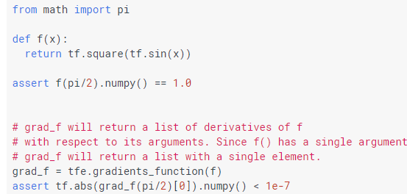
Automatic Differentiation - Reverse Mode
Based on backpropagation
Pro: Computes partial derivatives of one input f(x) with respect to all inputs in reasonable time
Con: Slow of high dimensional inputs and outputs
Required: Algorithm for computing f(x)

Slide 35
Backpropagation
Chain Rule:
Deal with composition of functions:
If f(u): differential function of u and u=g(x) is a differential function of x, then
y=f(g(x)) is a differential function of x
Neural network can be regarded as the composition of Layers Computation.
Then, Backpropagation is repeated application of the chain rule along a computational graph to compute the gradients of all inputs/parameters/intermediates

Slide 36
Toy Examples
Input
Output
W1.x
W2.z.z
x
z
The above function can be regarded as a two-layers neural network:
Layer One: z = W1.x
Layer Two: W2 * z * z

Slide 37
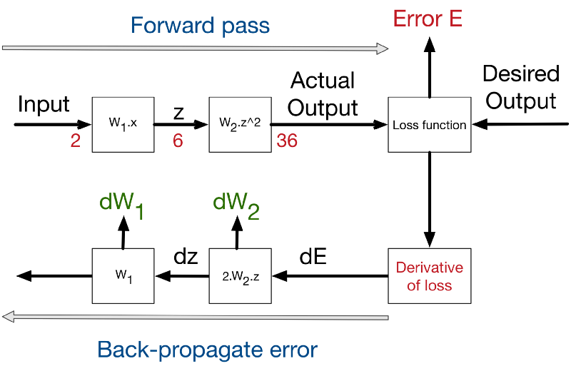
Toy Examples
Input -> Forward Calls -> Loss Function -> Derivative -> Backpropagation of Errors -> Deltas on the weight of this stage

Slide 38
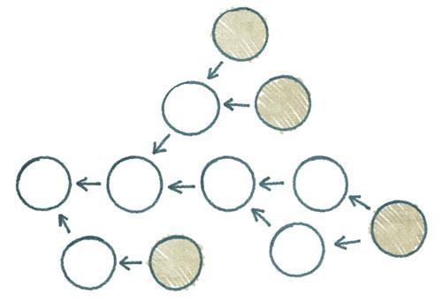
WorkFlow for Backpropagation
Forward Computation:
1 Write an algorithms for evaluation the function y=f(x). The algorithms defines a directed acyclic graph, where each variable is a node (i.e. the computation graph)
2 Visit each node in topological order
For variable u_{i} with inputs v₁,…,v_{N}
a. compute u_{i}=g_{i}(v₁,…, v_{n})
b. store the result at the node
3 Keep a stack of function calls and their parameters during the forward pass

Slide 39
WorkFlow for Backpropagation
Backward Computation:
1 Initialize all partial derivative dy/du_{j} to 0 and dy/dy=1
2 Visit each node in reverse topological order
For variable u_{i}=g_{i}(v₁,…, v_{n})
a. we already know dy/du_{i}
b. Increment dy/dv_{i} by (dy/du_{i})(du_{i}/dv_{j})
3 De-stacking through the function calls

Slide 40
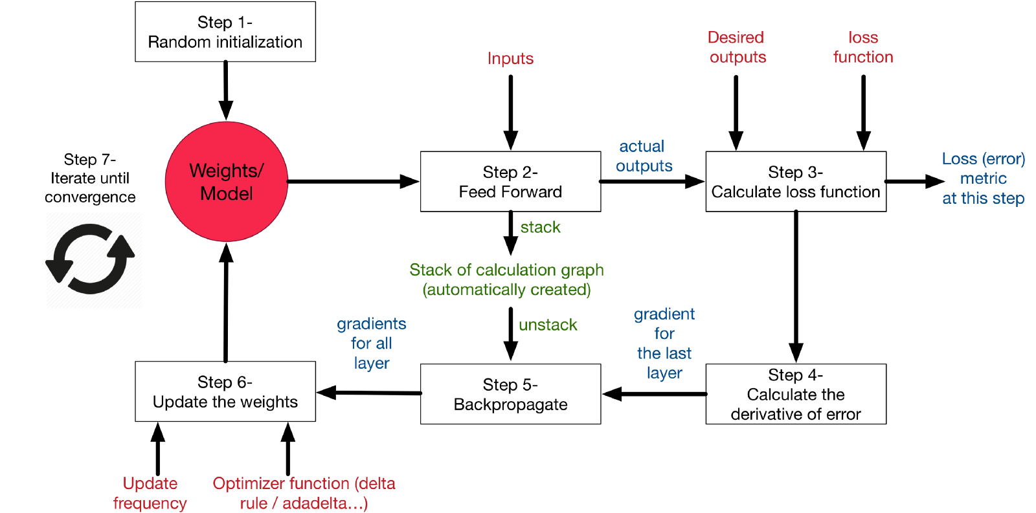
Auto-Diff Scheme

Slide 41


Neural Network Frameworks

Slide 42
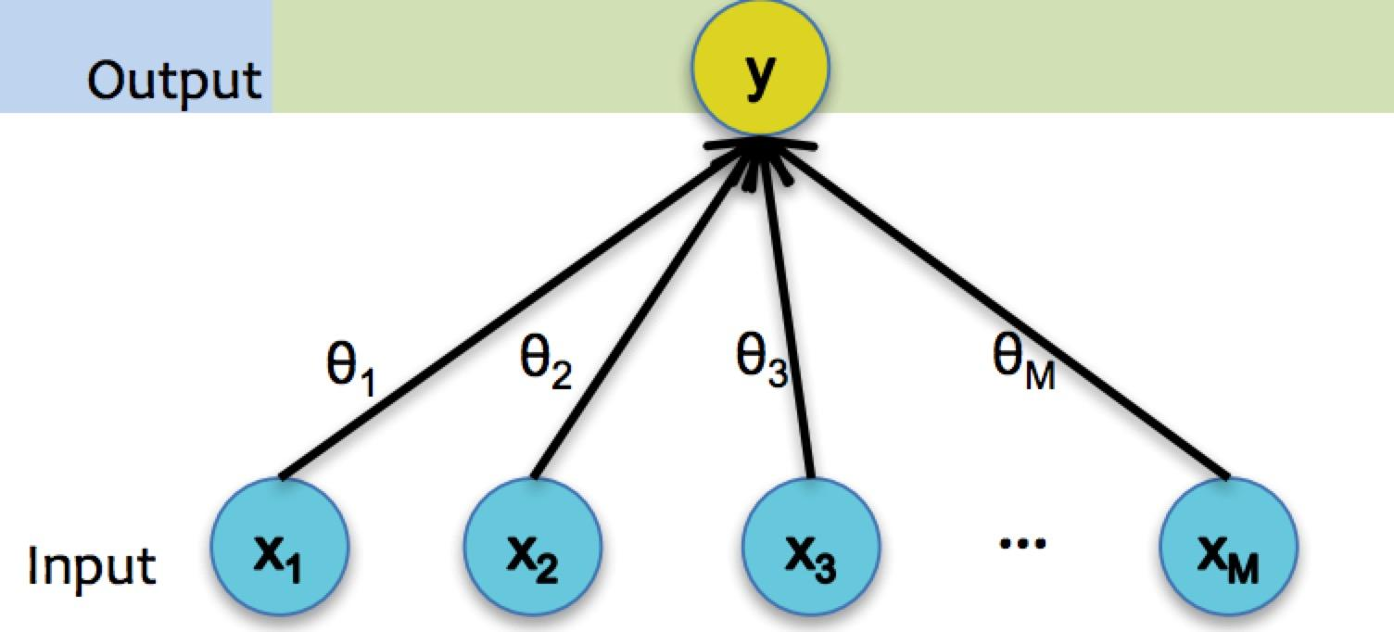
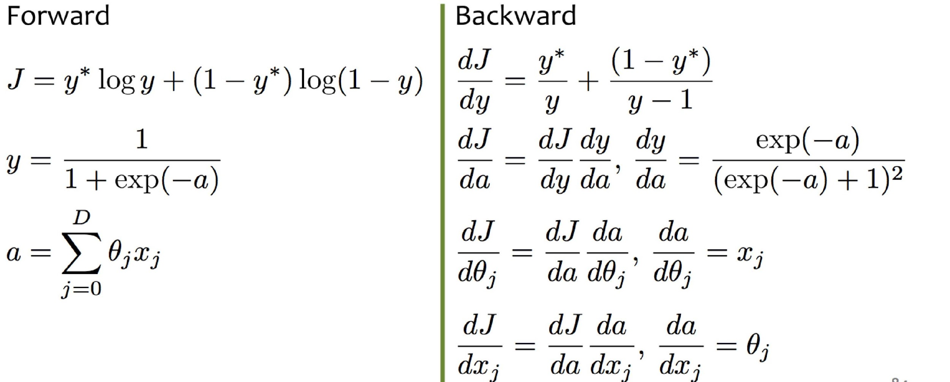
Logistic Regression

Slide 43
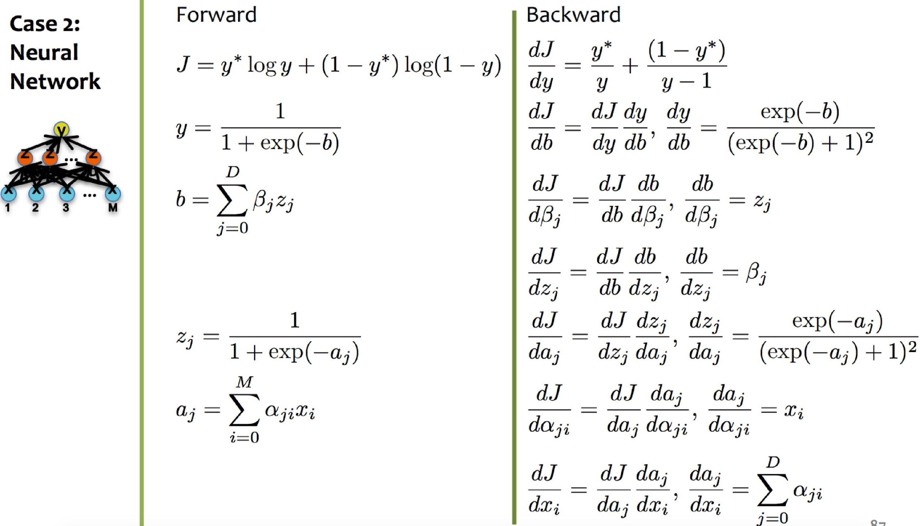
Two Layers Neural Network

Slide 44
Backpropagation
Backpropagation provides an efficient way to compute gradients
Is a special case of reverse-mode automatic differentiation
Deep learning frameworks such as tensorflow, pytorch all adopt this kind of automatic differentiation.

Slide 45
Initialization
Optimization for neural network in nature is a iterative method, which requires initialization.
Some general rules for initialization of model parameters:
Sometimes all 0 may be a bad idea (saddle point with tanh function),
Can not initialize all weights to the same value
Randomness should be incorporated
Bias terms can be safely set to be zero (only depend on the linear activation of that layer)

Slide 46
Normal Initialization
Initialize weights randomly, following standard normal distribution .
Two potential issues:
Best Practices: initialization should work with activation functions
Vanishing gradients
Exploding gradients: oscillating around the minima or number overflow

Slide 47
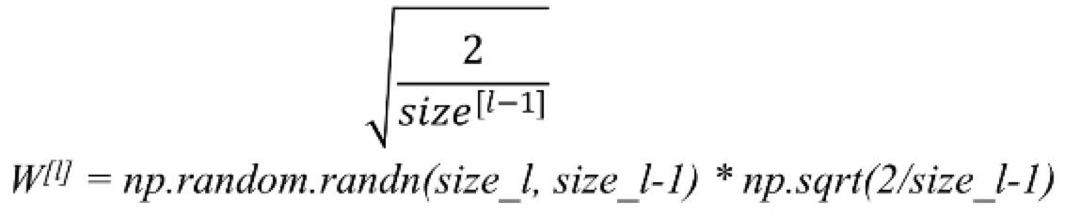
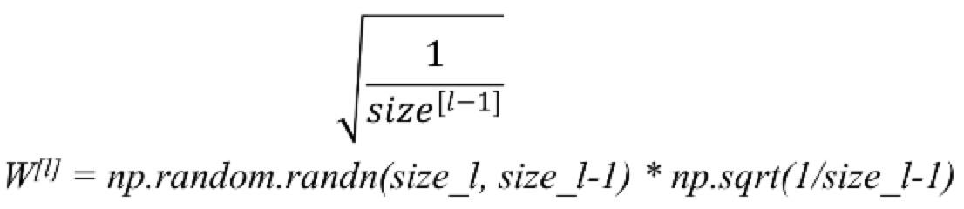
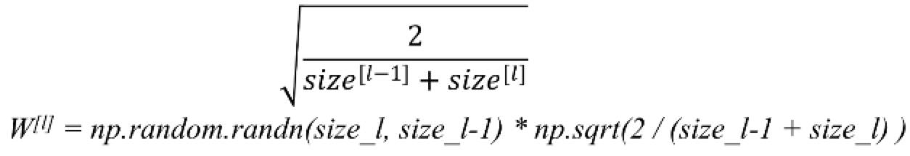
Some Hints
For ReLU:
For Tanh: Xavier initialization
Another Good Practice:
The gradients will not be vanished or exploded. It can avoid slow convergence and ensure that we do not keep oscillating off the minima.

Slide 48
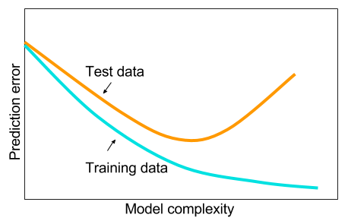
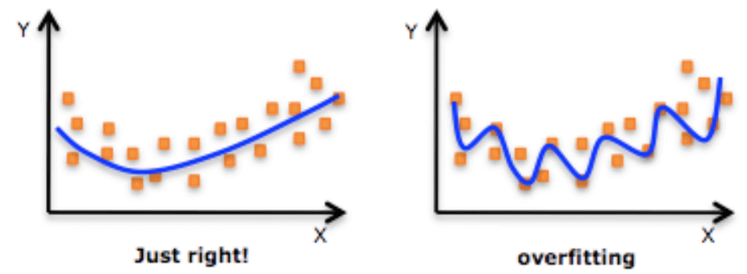
Overfitting
Overfitting refers to a model that models the training data too well, which negatively impact the models ability to generalize
Neural Network with a deep structure easily get overfitted

Slide 49
Overfitting for NN
Neural Network with a deep structure easily get overfitted.
Early Stopping
Parameters Regularization
Dropout
Train with more data or remove features

Slide 50
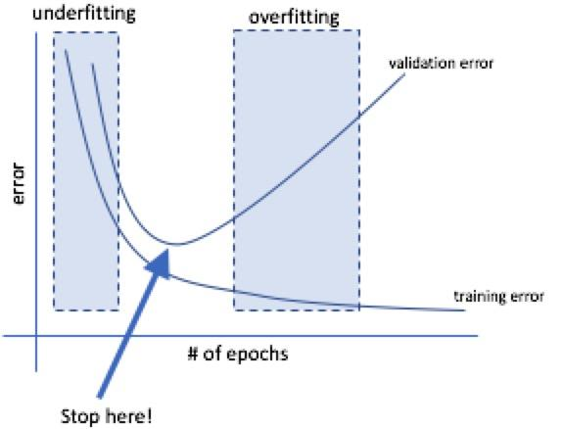
Early Stopping
Watch the validation curve
Stop updating the weights once validation error starts increasing

Slide 51
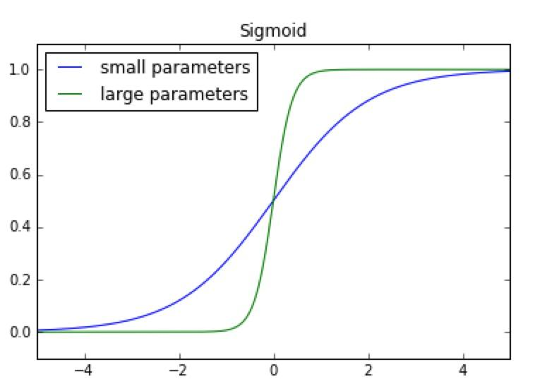
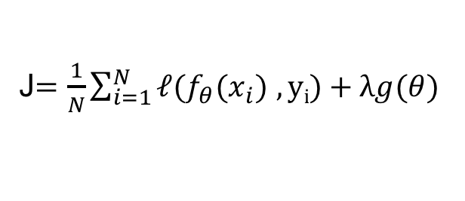
Regularization
In NN, inputs are linearly combined with parameters. Therefore, large parameters can amplify small changes in the input.
Large parameters may arbitrarily increases the confidence in our predictions.
In cost function, add regularization term to penalize parameters
The core idea is to prevent parameters from becoming excessively large during training
Control the degree to which we select to penalize large parameters

Slide 52
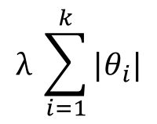
L1 Norm
L1 Regularization:
This expression is commonly used for feature selection as it tends to produce sparse parameter vectors where only the important features take on non-zero values

Slide 53
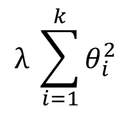
L2 Norm
L2 Regularization:
This expression does not tend to push less important weights to zero and typically produces better results when training a model.

Slide 54
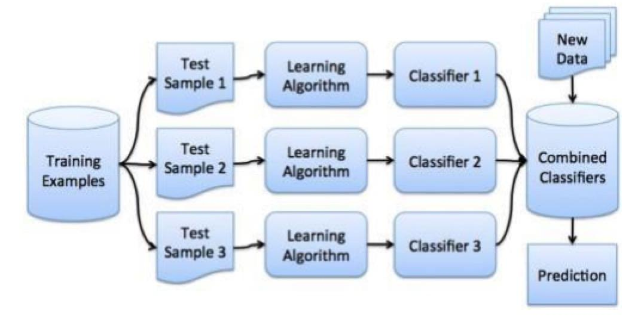
Dropout
Very simple way to prevent overfitting
The ideas comes from Bagging:
Sample training data and train several different classifiers
Classify test instance with entire ensemble of classifiers
Vote across classifiers for final decision

Slide 55
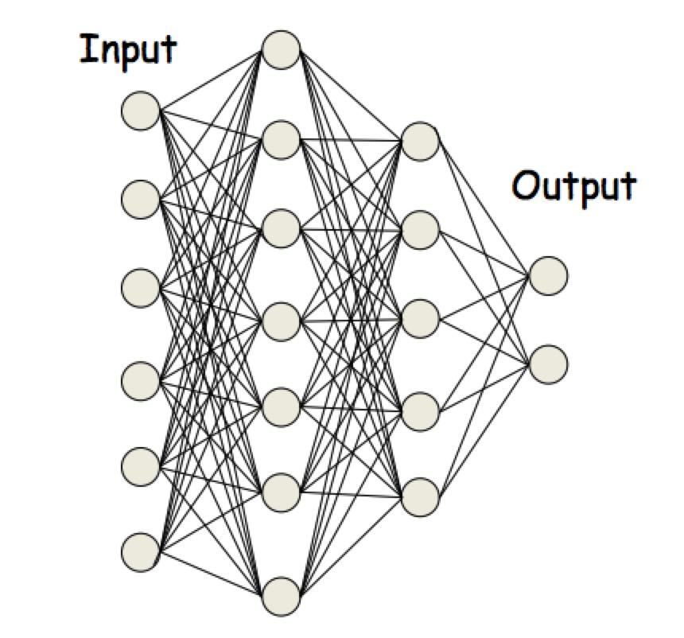


Dropout

Slide 56

Dropout
Due to randomness, the drop nodes changes for each input
BP is effectively performed only over the remaining network
For closed nodes, the gradients are zero

Slide 57

Dropout
Dropout forces the neuros to learn “rich” and redundant pattern
Without dropout, a layer may just clone its input to output.
Dropout forces the neuros to learn denser pattern

Slide 58


Dropout During Test
Kind of average voting

Slide 59

Dropout Effects
Experimental Studies on MINIST dataset:

Slide 60
General Tricks
Train with more data
Remove irrelevant features
If training data is complete and match the distribution of testing data, overfitting is no more a disaster.

Slide 61
Summary
Neural network is the recursive application of linear transformation and non-linear activation function.
Non-linear activation function is important
Gradient descent algorithms and various variants for optimization
Backpropagation for gradient computing in Neural Network
Auto-diff techniques are widely used in deep learning frameworks
Several regularization techniques to overcome overfitting

Slide 62


